Slide 1
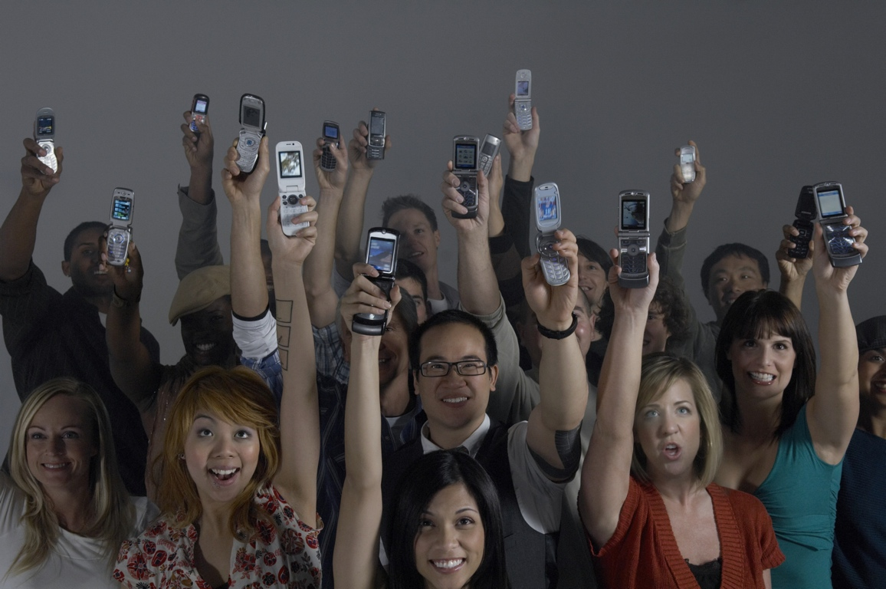


Slide 2
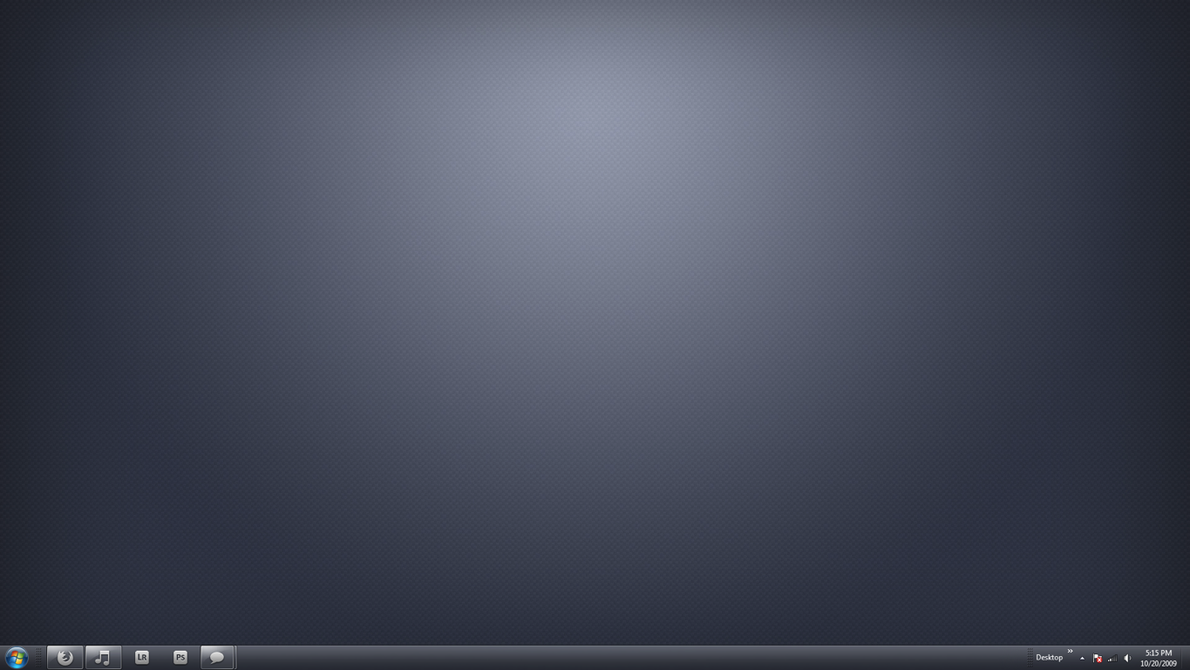
USECASE

Slide 3
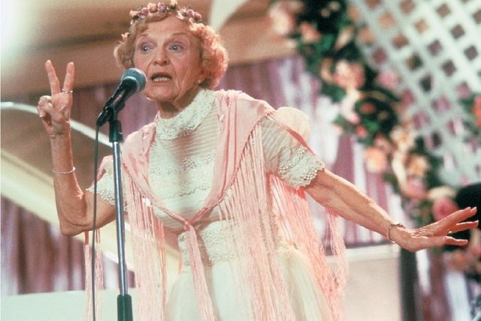

SING
EVERYBODY
LOVES
TO

Slide 4
EVERYBODY
LOVES
SHARE
TO

Slide 5
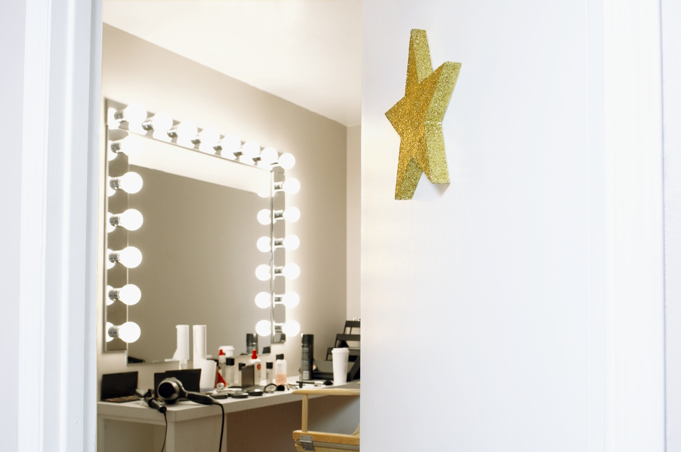
EVERYBODY
WANT TO BE
STAR
A

Slide 6
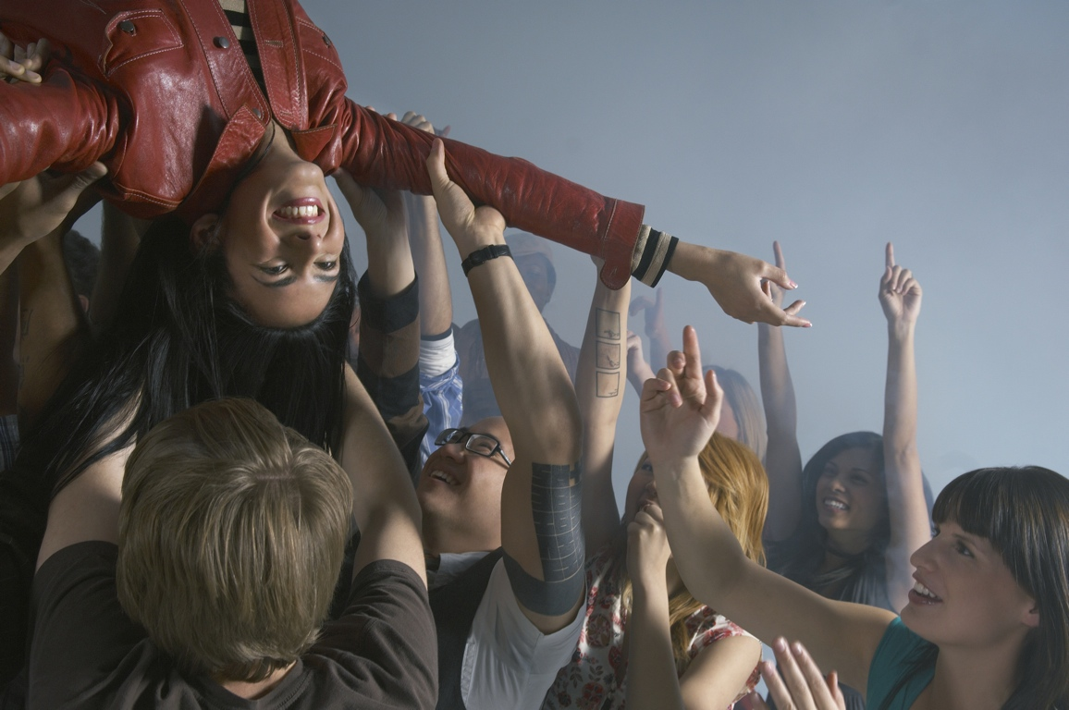
WE WILL MAKE YOU
WE WILL MAKE YOU
MEGASTAR
A
MEGASTAR
A
IN A CLICK!
IN A CLICK!

Slide 7
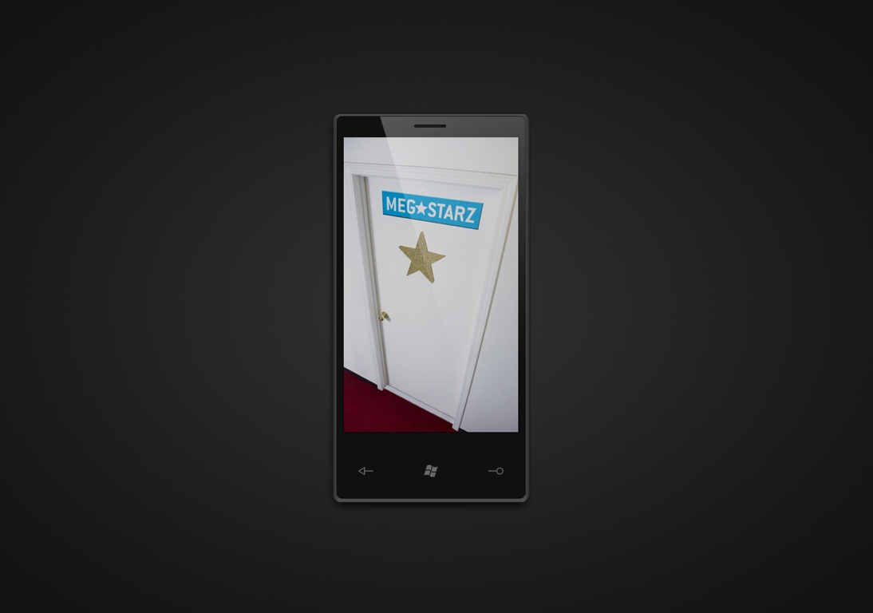
THE APP

Slide 8
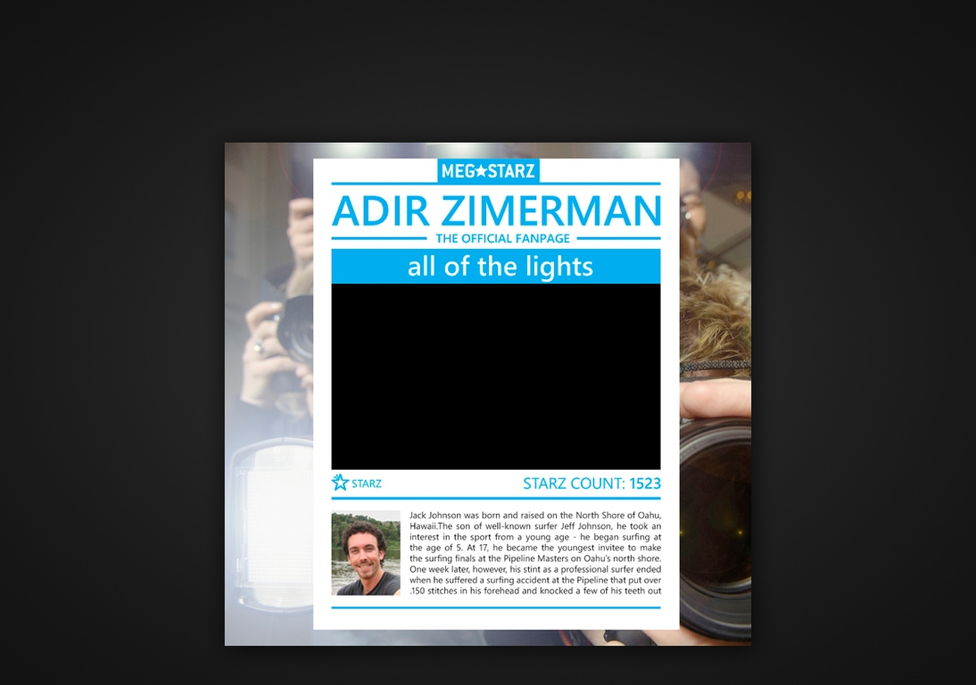

FACEBOOK FAN PAGE

Slide 9
TECHNOLOGIES
WP7
VIDEO CAPURE
BACKGROUND AUDIO
WCF
ANIMATION
MVVM
BLENDABILITY
FUNCTIONALITY ORIENTED IMPLEMENTATION
AZURE
C# FACEBOOK SDK
WCF REST
ENTITY FRAMEWORK 4
AZURE BLOB STORAGE

Slide 10
UI/UX
COLORS ADJUST TO USER SKIN
VECTOR IMAGING FOR LIGHT LOADING
INTERFACE
THE MICROSOFT WAY
USE IN METRO GRAPHICS STYLE
USE IN SEGOW WP FONT
CLEAN AND MINIMALIST LAYOUT
INTEGRATED STYLE, FIT TO WP7

Slide 11
BUSINESS MODEL
APP MARKET
APP
SONGS
CUSTOM MADE
EVENTS PR
TV AUDITIONS
ARTIST

Slide 12
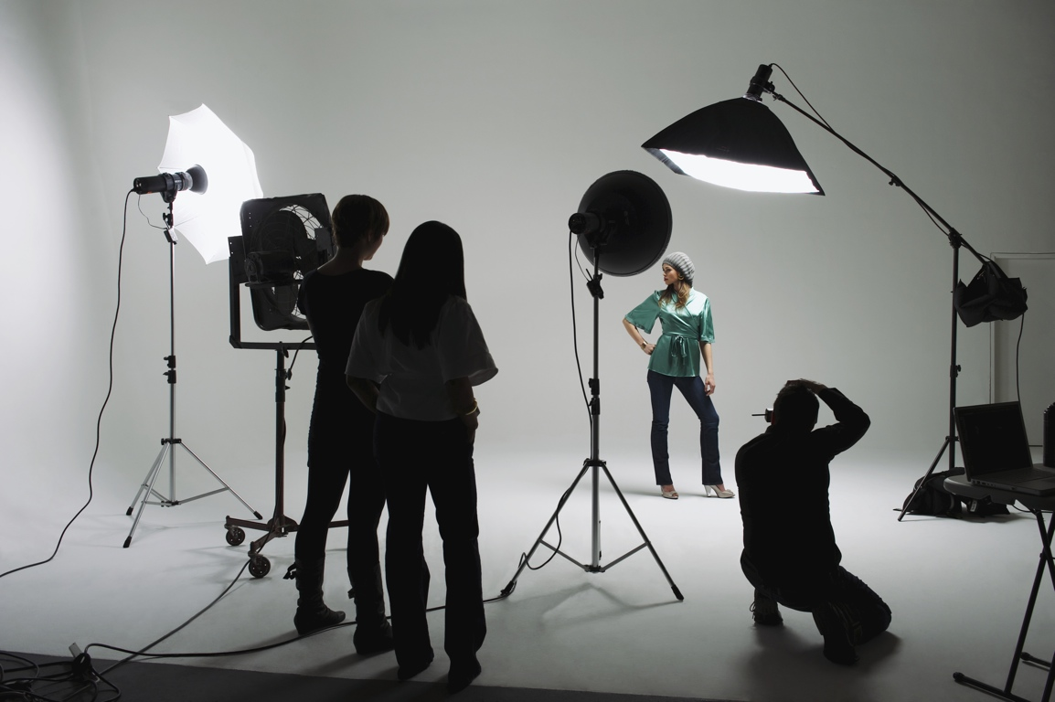
MEGASTARZ TEAM
THE BACKEND SPECIALIST
THE UI/UX GUY
THE TECHIE

Slide 13
OVERALL
GREAT EXPERIENCE
36 EXHAUSTING HOURS
Pushed WP7 to the end….
GOODBYE DREAMSPARK, WELCOME BIZPARK

Slide 14
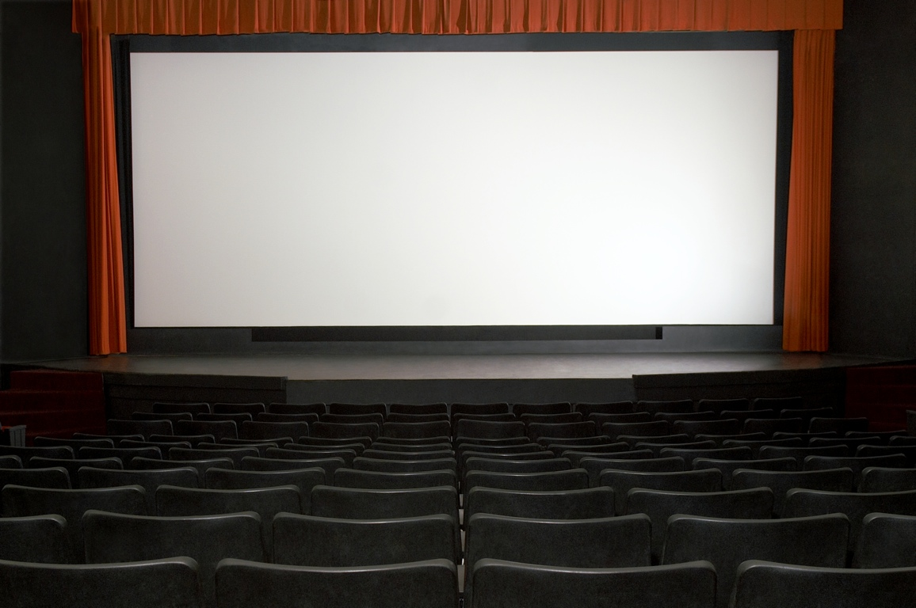

CHOOSE A SONG SING ALONG
BE A MEGAST

